Slide 1
DoH!
Geoff Huston
APNIC

Slide 2
Words of Caution!
I’m speaking after Paul
And I’m speaking on the DNS
This may not end well!
But here goes…

Slide 3
What defines “The Internet”?
The 1990’s answer was all about ‘reachability’
  The Internet was this connected domain where every connected device could send IP packets to any other connected device
  And the packet I sent to you is the packet you got
    Modulo TTL and fragmentation and reassembly
But then we invented enterprise networks, firewalls and security realms, NATs and all kinds of “value added” network services
And the entire architecture of the Internet shifted to a client/server architecture
  Clients could interact with servers, but not with each other

Slide 4
What defines “The Internet”?
Then we turned to the server model and started playing with anycast to improve server performance by service replication
Today:
  Clients don’t have a public IP address (NATs)
  Server’s don’t have a unique public IP address (Anycast)
  So what is the address architecture of the Internet?

Slide 5
What defines “The Internet”?
If the Internet used be defined by a communications domain that shared a common name and address infrastructure then we’ve broken the address part and its never going to come back!
The Internet is now defined only by a common name space

Slide 6
The DNS as the Internet’s Glue
RFC 2826:
Effective communications between two parties requires two essential preconditions:
The existence of a common symbol set, and
The existence of a common semantic interpretation of these symbols.
Failure to meet the first condition implies a failure to communicate at all, while failure to meet the second implies that the meaning of the communication is lost.

Slide 7
The Internet’s Domain Name System
What is it?
  A common set of syntax rules that defines ‘valid’ DNS names
  A hierarchically structured distributed database
  A common name resolution protocol that can consult this database and map a name to a value
  A collection of engines (resolvers and servers) that run a common query/response protocol that performs name resolution

Slide 8
The DNS as Internet Infrastructure
The Theory:
  Names are visible to all
  Names resolve consistently to the same values all the time
The Practice:
  How much of these two principles can we break and still get away with it?

Slide 9
Old School DNS
The DNS is operated as a common infrastructure (not application specific)
The common infrastructure assumes a common and consistent name set in the DNS that is assessible to all
If a name is defined than its definition is the same for all queriers
If a name doesn’t exist it doesn’t exist for every querier

Slide 10
Old School DNS
DNS resolvers configured with IP addresses as part of the connection context (DHCP)
DNS recursive resolvers operated by the ISP as part of the ISP’s service to their users
DNS authoritative services provided in various ways (often as part of web hosting environments)
Applications used gethostbyname() and tapped into the DNS common infrastructure

Slide 11
Old School DNS
DNS Authoritative Servers
ISP-operated Recursive Resolvers
Platform Stub DNS libraries

Slide 12
DNS (Ab)Use
Split Horizon DNS
NXDOMAIN substitution
TTL munging and Cache manipulation
Fake Roots
White Lies: DNS64
DNS Geolocation
EDNS Client Subnet

Slide 13
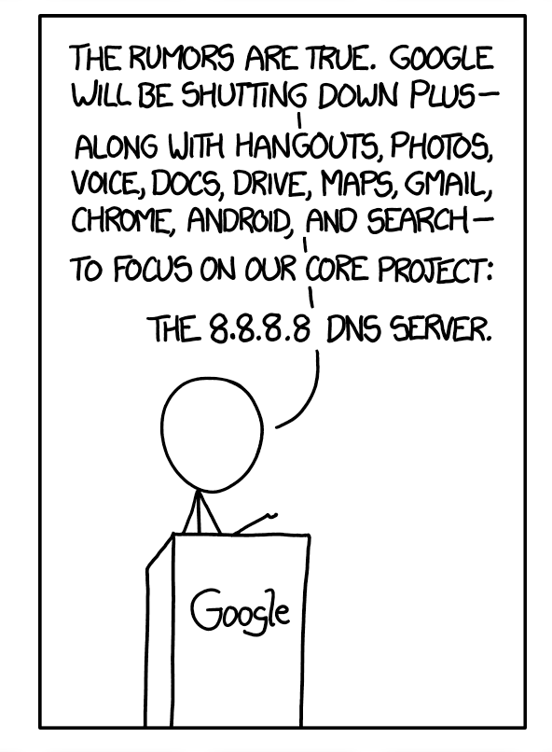
The Path to DoH
The DNS leaks information like a sieve
https://xkcd.com/1361/

Slide 14
Why pick on the DNS?
The DNS is very easy to tap
  Its open and unencrypted
DNS traffic is easy to tamper with
  Its payload is not secured and tampering cannot be detected
  Its predictable and false answers can be readily inserted
The DNS is hard for users to trace
  Noone knows exactly where their queries go
  Noone can know precisely where their answers come from
The DNS is used by everyone

Slide 15

Second-hand DNS queries are a business opportunity these days

Slide 16
How can we improve DNS Privacy?
And not alter the DNS architecture in fundamental ways
Move away from clear queries and responses and use session encryption

Slide 17
Encrypting the session
Today the standard tool is TLS, which uses dynamically generated session keys to encrypt all traffic between two parties
We could use TLS between the end client and the client’s recursive resolver
  We could probably do the same between recursive resolvers and authoritative servers, but the IETF is doing this one step at a time

Slide 18
DoT - DNS over TLS
TLS is a TCP ‘overlay’ that adds server authentication and session encryption to TCP
TLS uses an initial handshake to allow a client to:
  Validate the identity of the server
  Negotiate a session key to be used in all subsequent packets in the TCP session
RFC 7858, RFC 8310, RFC8446
Client
Server
Client hello
Supported AEADS
Signatures
Key Share
Server hello
Chosen AEAD
Key Share
Certificate
Signature
Finished
Finished
DNS Query
DNS Response
DNS over TLS 1.3

Slide 19
DoT - DNS over TLS
Similar to DNS over TCP:
  Open a TLS session with a recursive resolver
  Pass the DNS query using DNS wireline format
  Wait for the response
Can use held DNS sessions to allow the TLS session to be used for multiple DNS queries
The queries and the responses are hidden from intermediaries
The client may validate the recursive resolver’s identity …

Slide 20
Who is at the other end of the TLS session?
Strict Mode:
  Connect by name, and perform a TLS handshake based on authentication of the offered name certificate
    (which sounds a whole lot better than it really is due to the WEB PKI CA mess!)
Opportunistic Mode:
  Use an unauthenticated encrypted session
    (the client has no idea who it is talking to, but whatever is said cannot be eavesdropped in any case!)

Slide 21

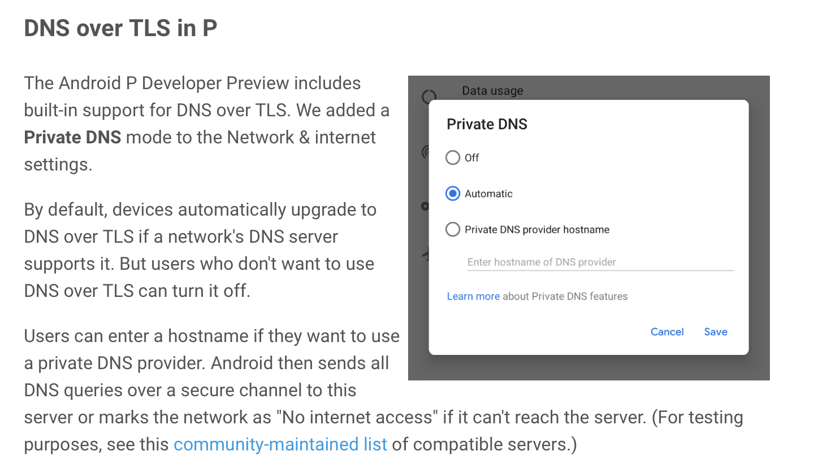
DNS over TLS and Android
https://android-developers.googleblog.com/2018/04/dns-over-tls-support-in-android-p.html

Slide 22
DoT - DNS over TLS
Its TCP not UDP -- May generate a higher recursive resolver memory load as each client may have a held state with one or more recursive resolvers
The TCP session state is on port 853
  DNS over TLS can be readily blocked by middleware
The privacy is relative, as the recursive resolver still knows all your DNS queries
Supported by Bind (stunnel), Unbound, KNOT, DNSDist
Open DoT Resolvers from Google, Cloudflare (and maybe others)

Slide 23
But once you are using TLS it’s a short step to…

Slide 24
DoH - DNS over HTTPS
DNS over HTTPS
Uses an HTTPS session with a resolver
Similar to DNS over TLS, but with HTTP object semantics
Uses TCP port 443, so can be masked within other HTTPS traffic
Uses DNS wire format
DOT
DOH
DNS
DNS
TLS
HTTP
TCP
TLS
IP
TCP
IP

Slide 25
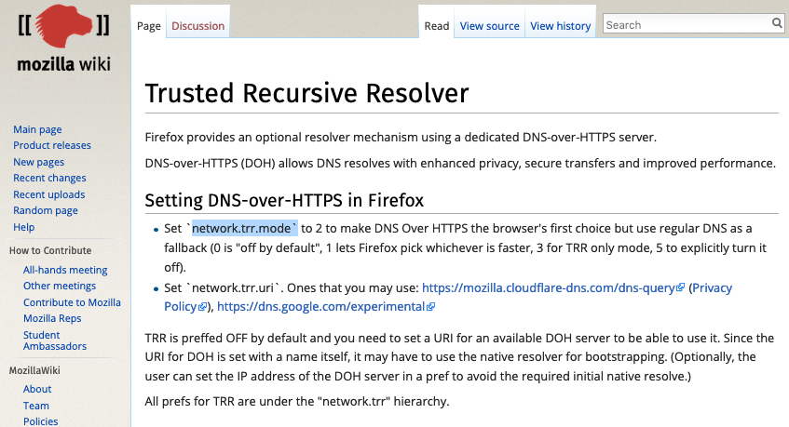
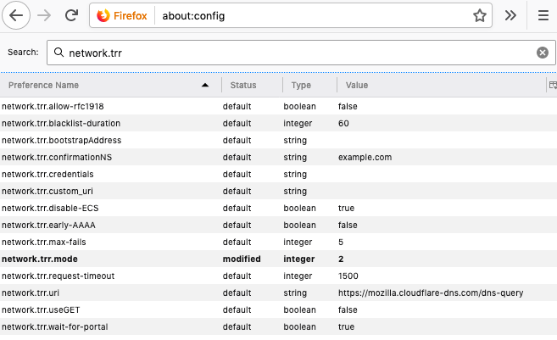
DoH - DNS within the Browser

Slide 26
DoH - DNS within the Browser
Firefox’s “Trusted Recursive Resolver”
Avoids using the local DNS resolver library and local DNS infrastructure
Has the browser sending its DNS queries directly to a trusted resolver over HTTPS
Servers available from Cloudflare, Google, CleanBrowsing

Slide 27
Why DoH?
Lives on TCP port 443
DNS content denoted by “application/dns- message”, allowing a server to distinguish DNS queries within the HTML stream (which is encrypted in TLS with HTTPS)
  i.e. DNS queries and responses can be readily intertwined in other HTTPS traffic

Slide 28
Why DoH?
Applications can effectively hide DNS transactions from the network
  TLS 1.3 and ESNI can remove all visible indication of the DoH server name from the network
  DoH queries and responses can use both DNS and HTML padding to disguise the payload size
Applications can effectively hide DNS transactions from the platform
  No DNS query logs on the platform
  No cross-application spyware on the platform

Slide 29
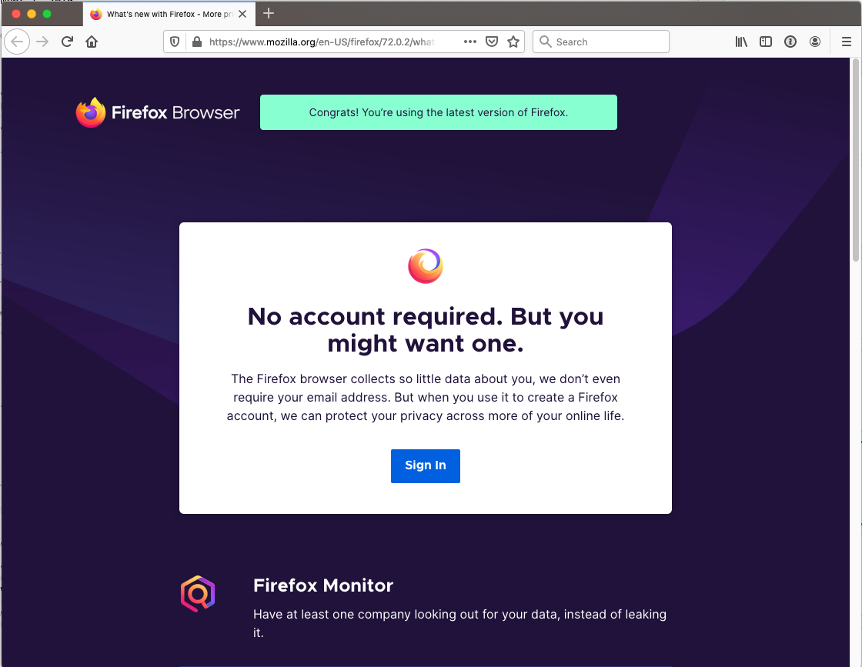
DoH Bypass
bypass
1.1.1.1
DNS Authoritative Servers
Platform Stub DNS libraries
ISP-operated Recursive Resolvers

Slide 30
DoH Futures?
HTML prefetch?
  How can the client ascertain if the pushed data is genuine?
  What is the use context of the pushed name resolution?
DoH only names
  Implicit client identification allowing for client customisation
Morph the DNS into the WEB infrastructure?
  Use HTTPS content distribution infrastructure for DoH web objects

Slide 31
If the web is doing it… why not the DNS?

Slide 32
DoQ - DNS over QUIC
QUIC is a transport protocol originally developed by Google and passed over to the IETF for standardised profile development
QUIC uses a thin UDP shim and an encrypted payload
  The payload is divided into a TCP-like transport header and a payload
The essential difference between DOT and DOQ is the deliberate hiding of the transport protocol from network middleware with the use of QUIC
No known implementations of DNS over QUIC exist, though IETF work continues
draft-huitema-quic-dns-quic-07
DOT
DOH
DOQ
DNS
DNS
DNS
TLS
HTTP
QUIC
TCP
TLS
TLS
TCP
UDP
IP
IP
IP

Slide 33
DoT, DoH, DoQ
Its not a rule, but
  It seems that applications (browsers) are looking to DoH and possibly DoQ
  Platforms are looking to use DoT as an alternative to DNS in the clear

Slide 34
Whose DNS is it anyway?
ISP-provided DNS infrastructure
User configured DNS resolvers can override ISP defaults
  Although open DNS and DoT can be blocked at the ISP level by port level blocking and interception
  It’s unclear whether DoH and DoQ can be blocked so readily
Application selected resolvers can override ISP and platform configured defaults
  It’s unclear whether an applications use of DoH can even be detected by the platform, let alone by the ISP

Slide 35
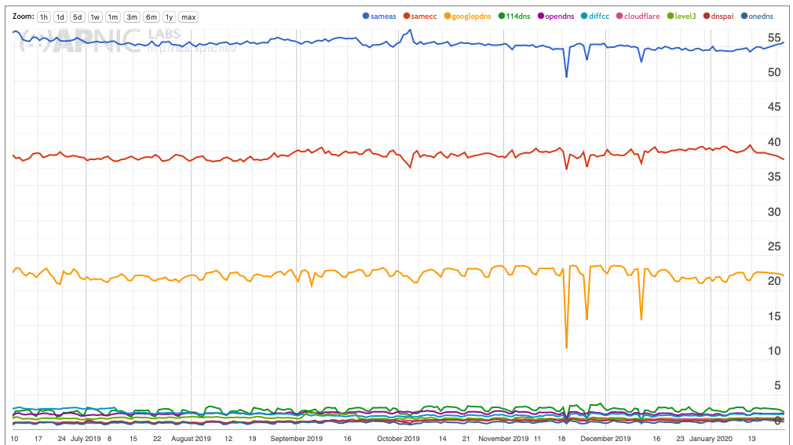
DNS use in the Internet
Top 10
Provider’s DNS
Same country
(Provider’s DNS)
Google’s Public
DNS
All the rest (Open DNS platforms)

Slide 36
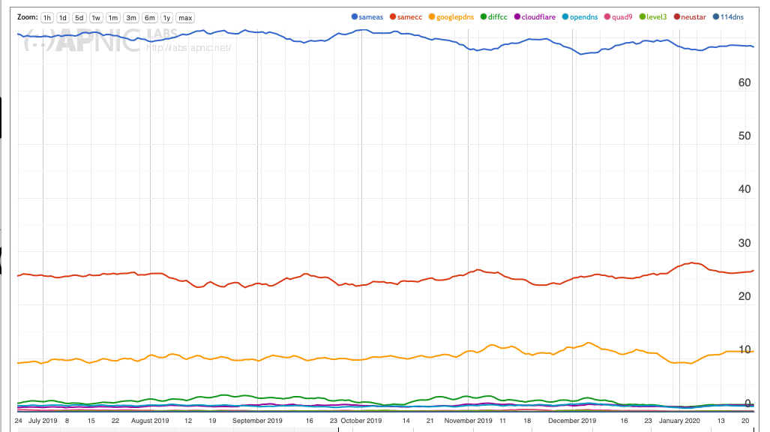
DNS use in New Zealand
Top 10
Provider’s DNS
Same country
(Provider’s DNS)
Google’s Public
DNS
All the rest (Open DNS platforms)

Slide 37
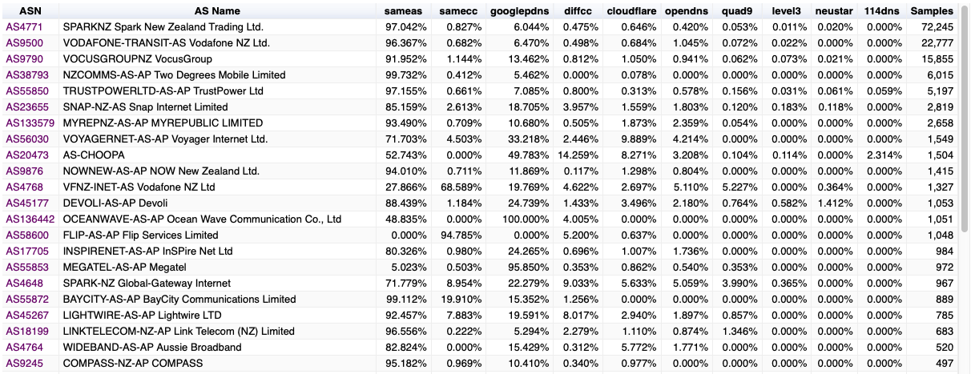
DNS use in New Zealand

Slide 38
Thanks!

