Slide 1
Measuring the KSK Roll
Geoff Huston
APNIC Labs

Slide 2
KSK Roll Measurement Objective
What number of users are at risk of being impacted by the KSK Roll?

Slide 3
What we would like the DNS to be
Client
DNS Resolver
DNS Server

Slide 4
What we suspect is in the DNS
Client
DNS Resolver
DNS Server
DNS Server
DNS Resolver
DNS Resolver
DNS Resolver
DNS Server
DNS Resolver
DNS Resolver
DNS Resolver
DNS Resolver
DNS Resolver
DNS Resolver
DNS Resolver
DNS Resolver
DNS Resolver

Slide 5
Signalling via Queries
Client
DNS Resolver
Server
Queries
DNS Resolver
DNS Resolver
DNS Resolver
DNS Resolver
The query contains added resolver information which passes inward in the DNS towards the authoritative server(s)
DNS Resolver
DNS Resolver
DNS Resolver
DNS Resolver
DNS Resolver
DNS Resolver
DNS Resolver
DNS Resolver

Slide 6
Signalling via Responses
Client
DNS Resolver
Server
Responses
DNS Resolver
DNS Resolver
DNS Resolver
DNS Resolver
The response contains added information or altered behavious which passes backward in the DNS towards the original querier
DNS Resolver
DNS Resolver
DNS Resolver
DNS Resolver
DNS Resolver
DNS Resolver
DNS Resolver
DNS Resolver

Slide 7
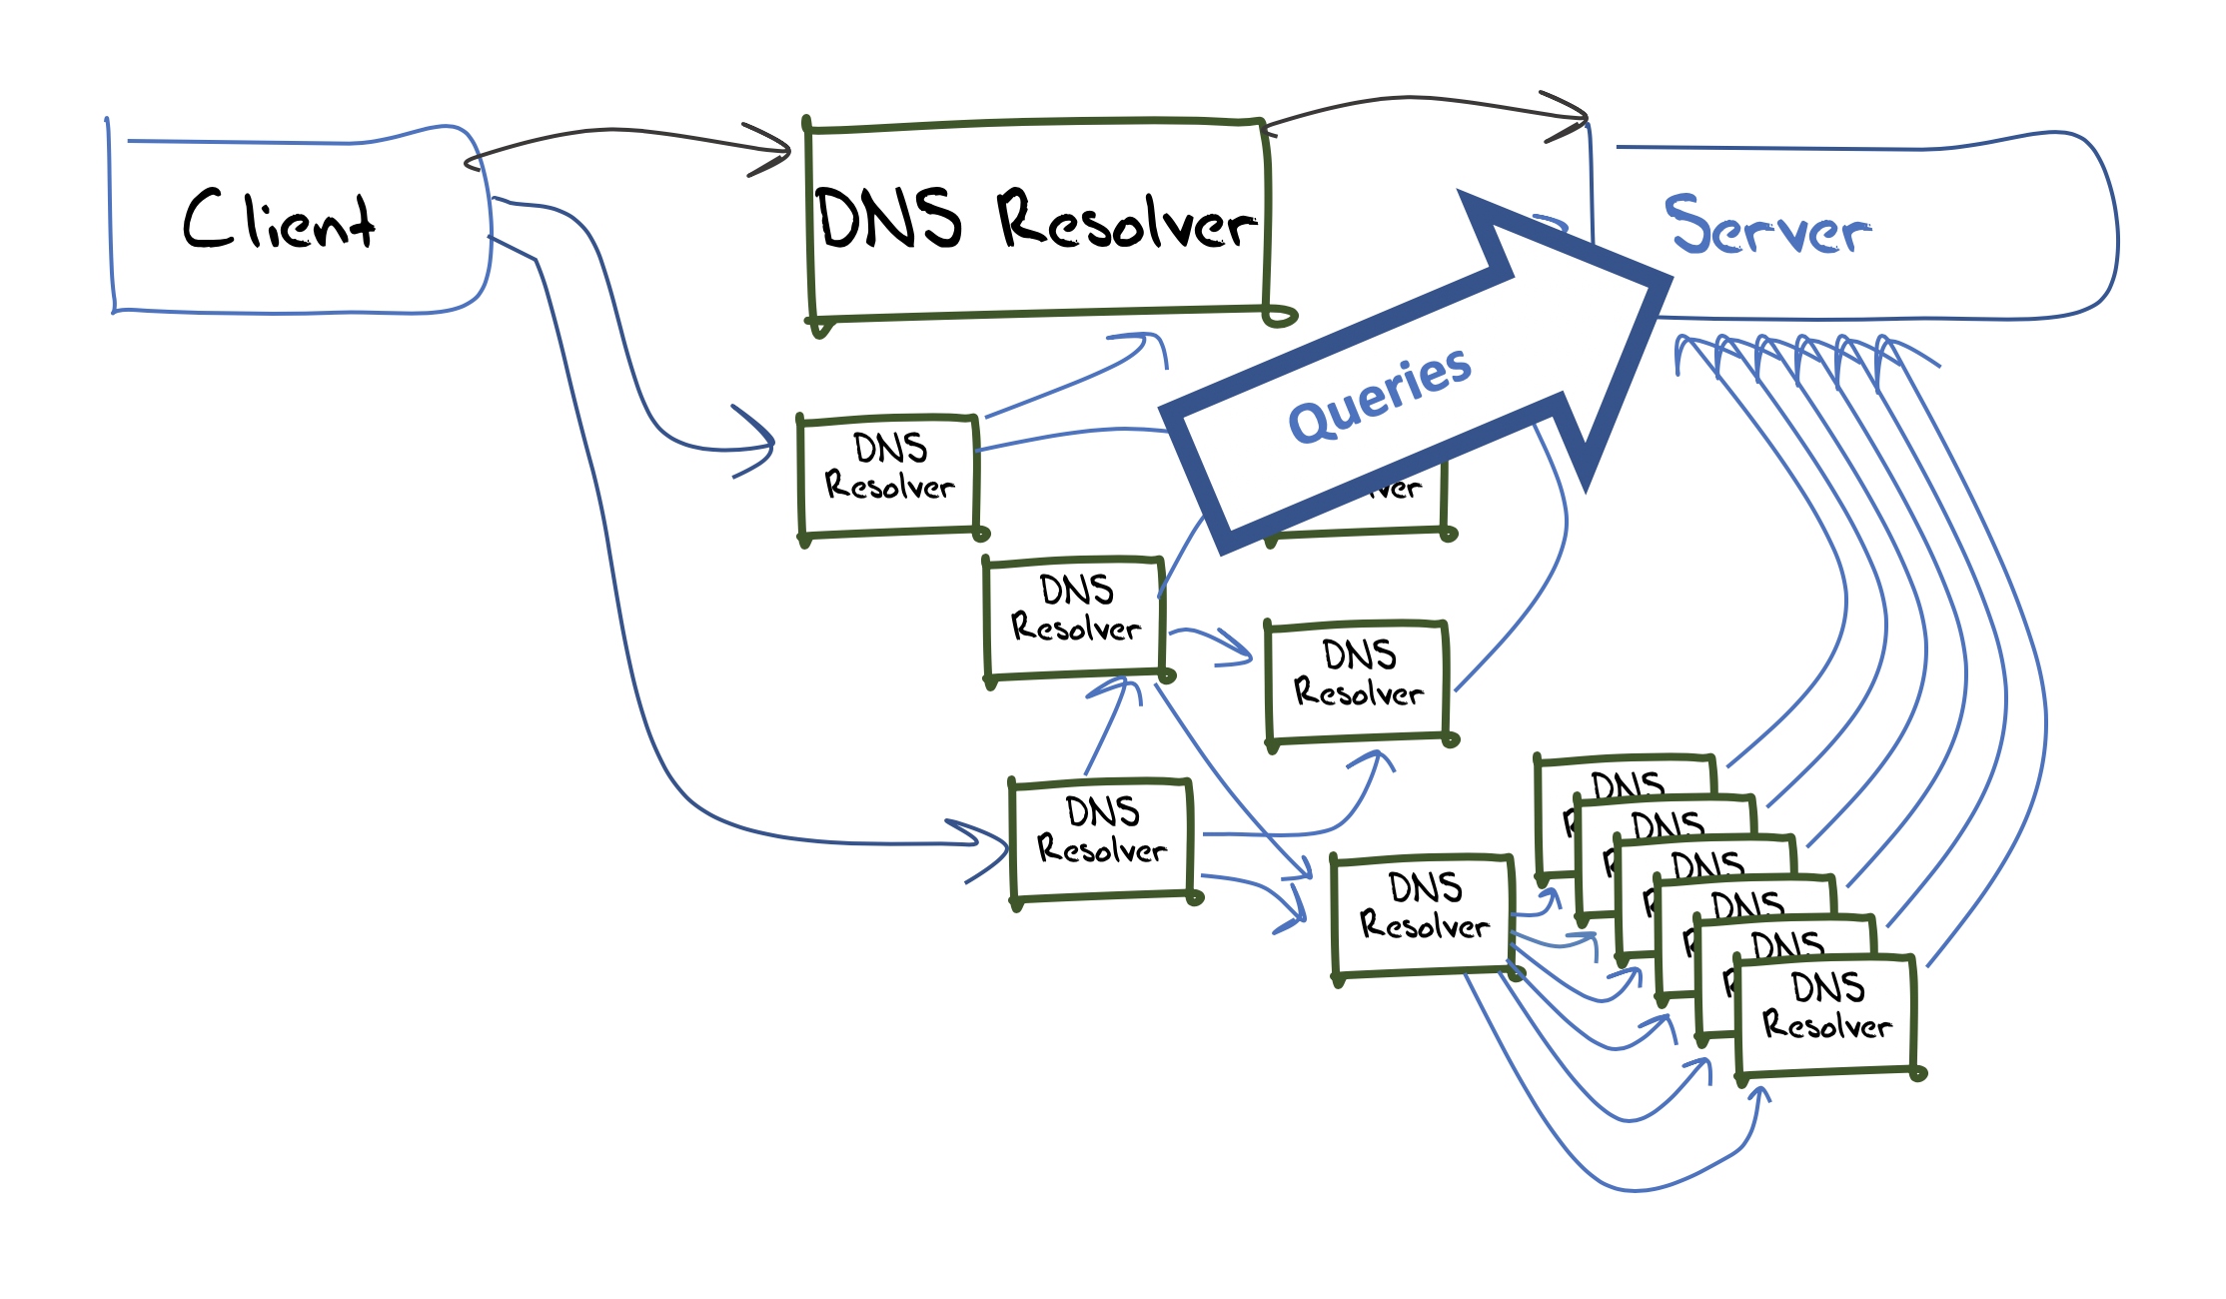
Measuring Resolvers with RFC 8145
Getting resolvers to report on their local trusted key state
  A change to resolver behavior that requires deployment of new resolver code
  Resolvers that support the RFC 8145 signal mechanism periodically include the key tag of their locally trusted keys into a query directed towards the root servers

Slide 8
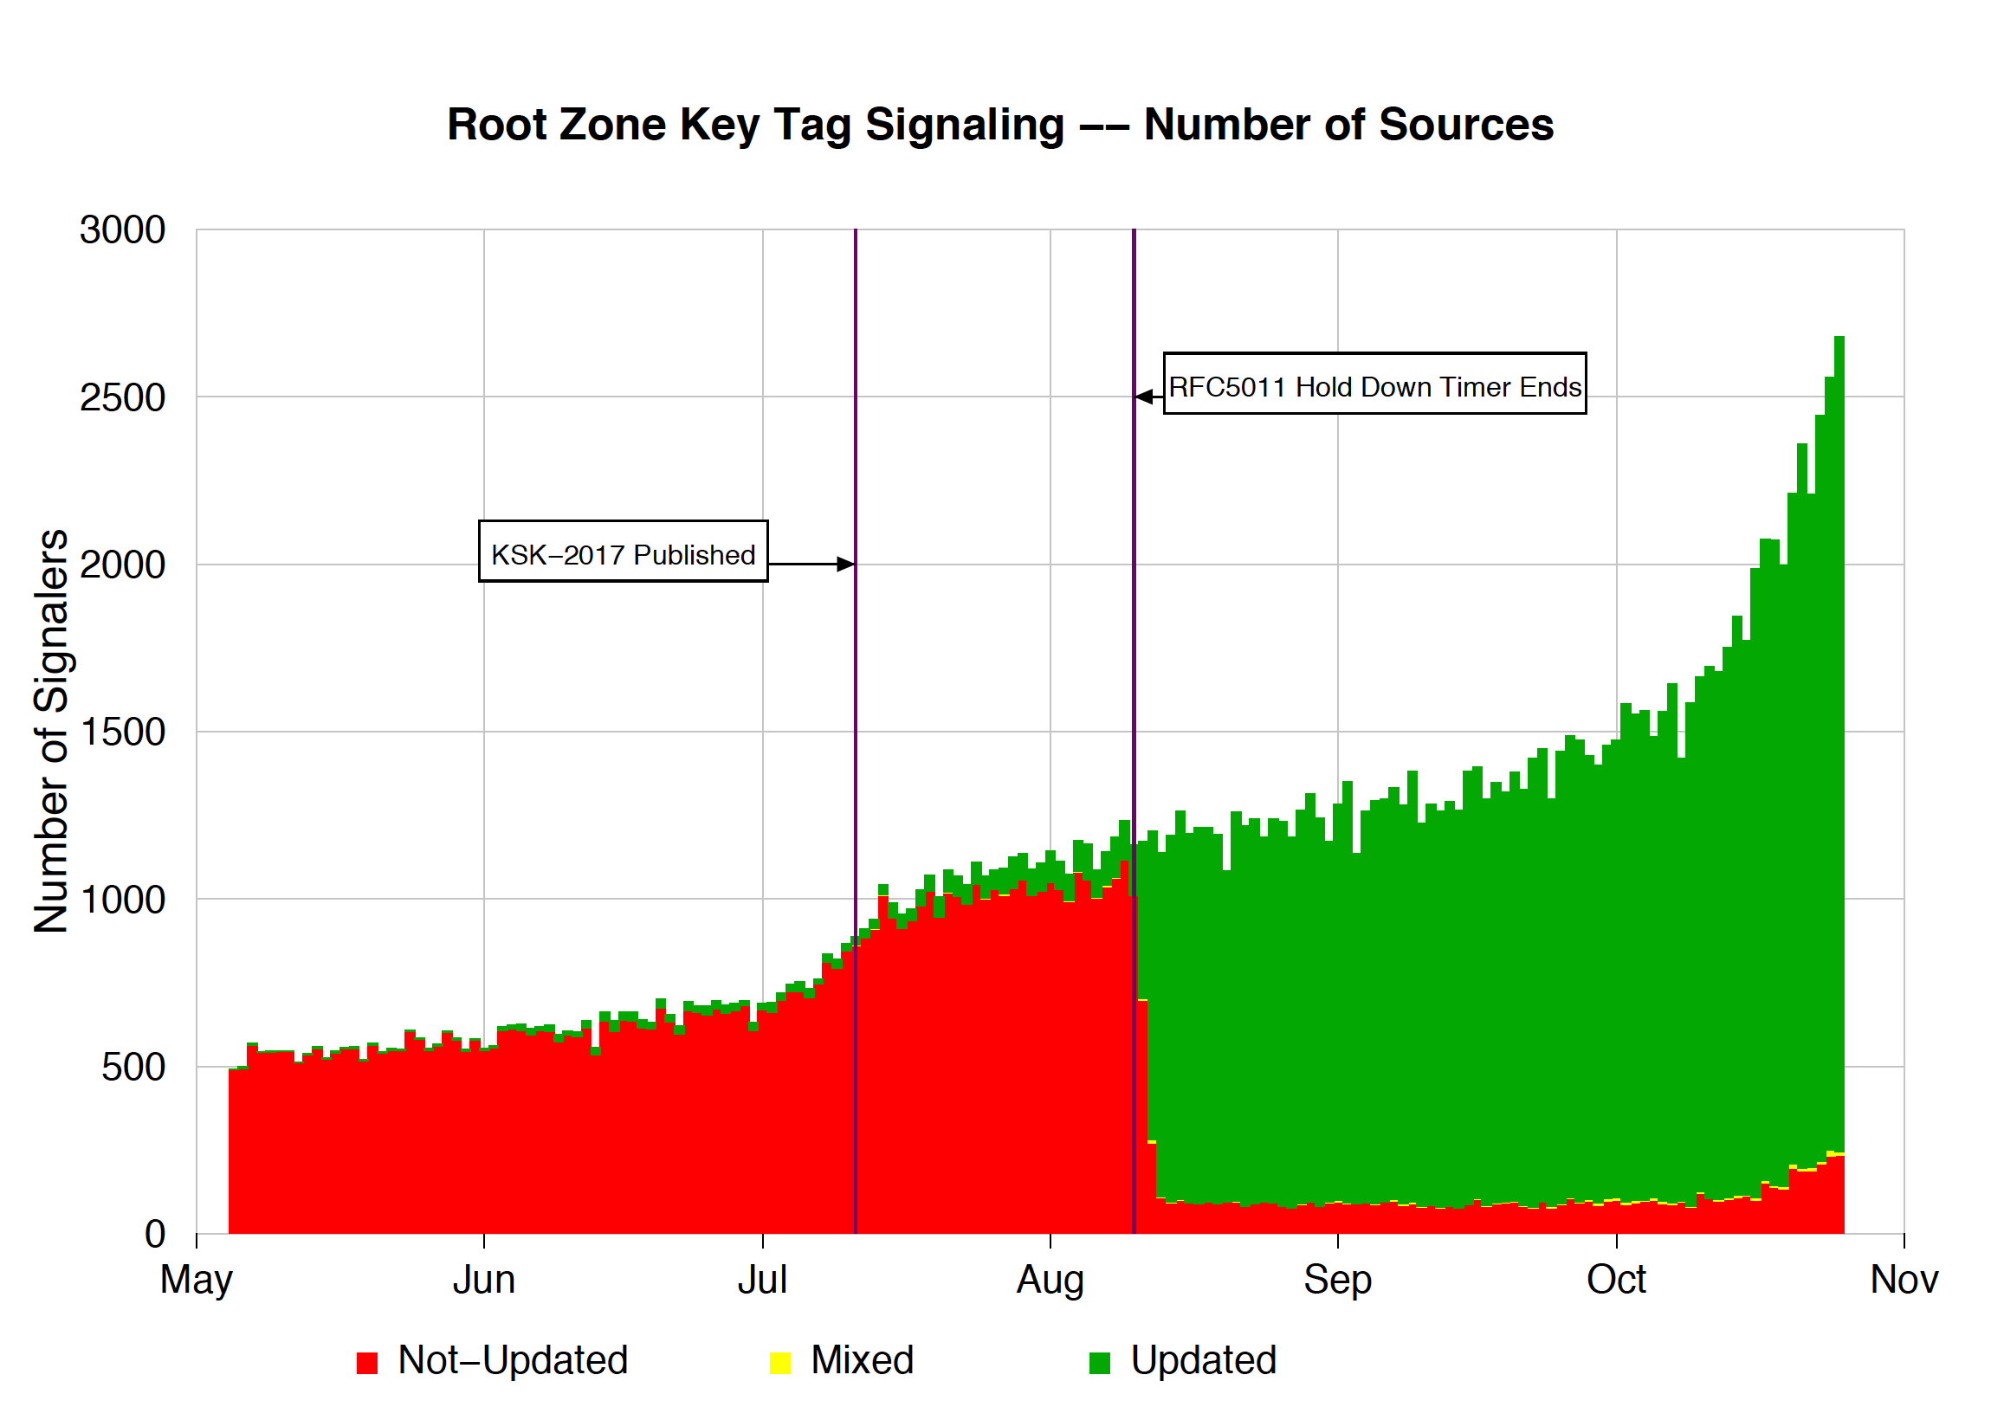
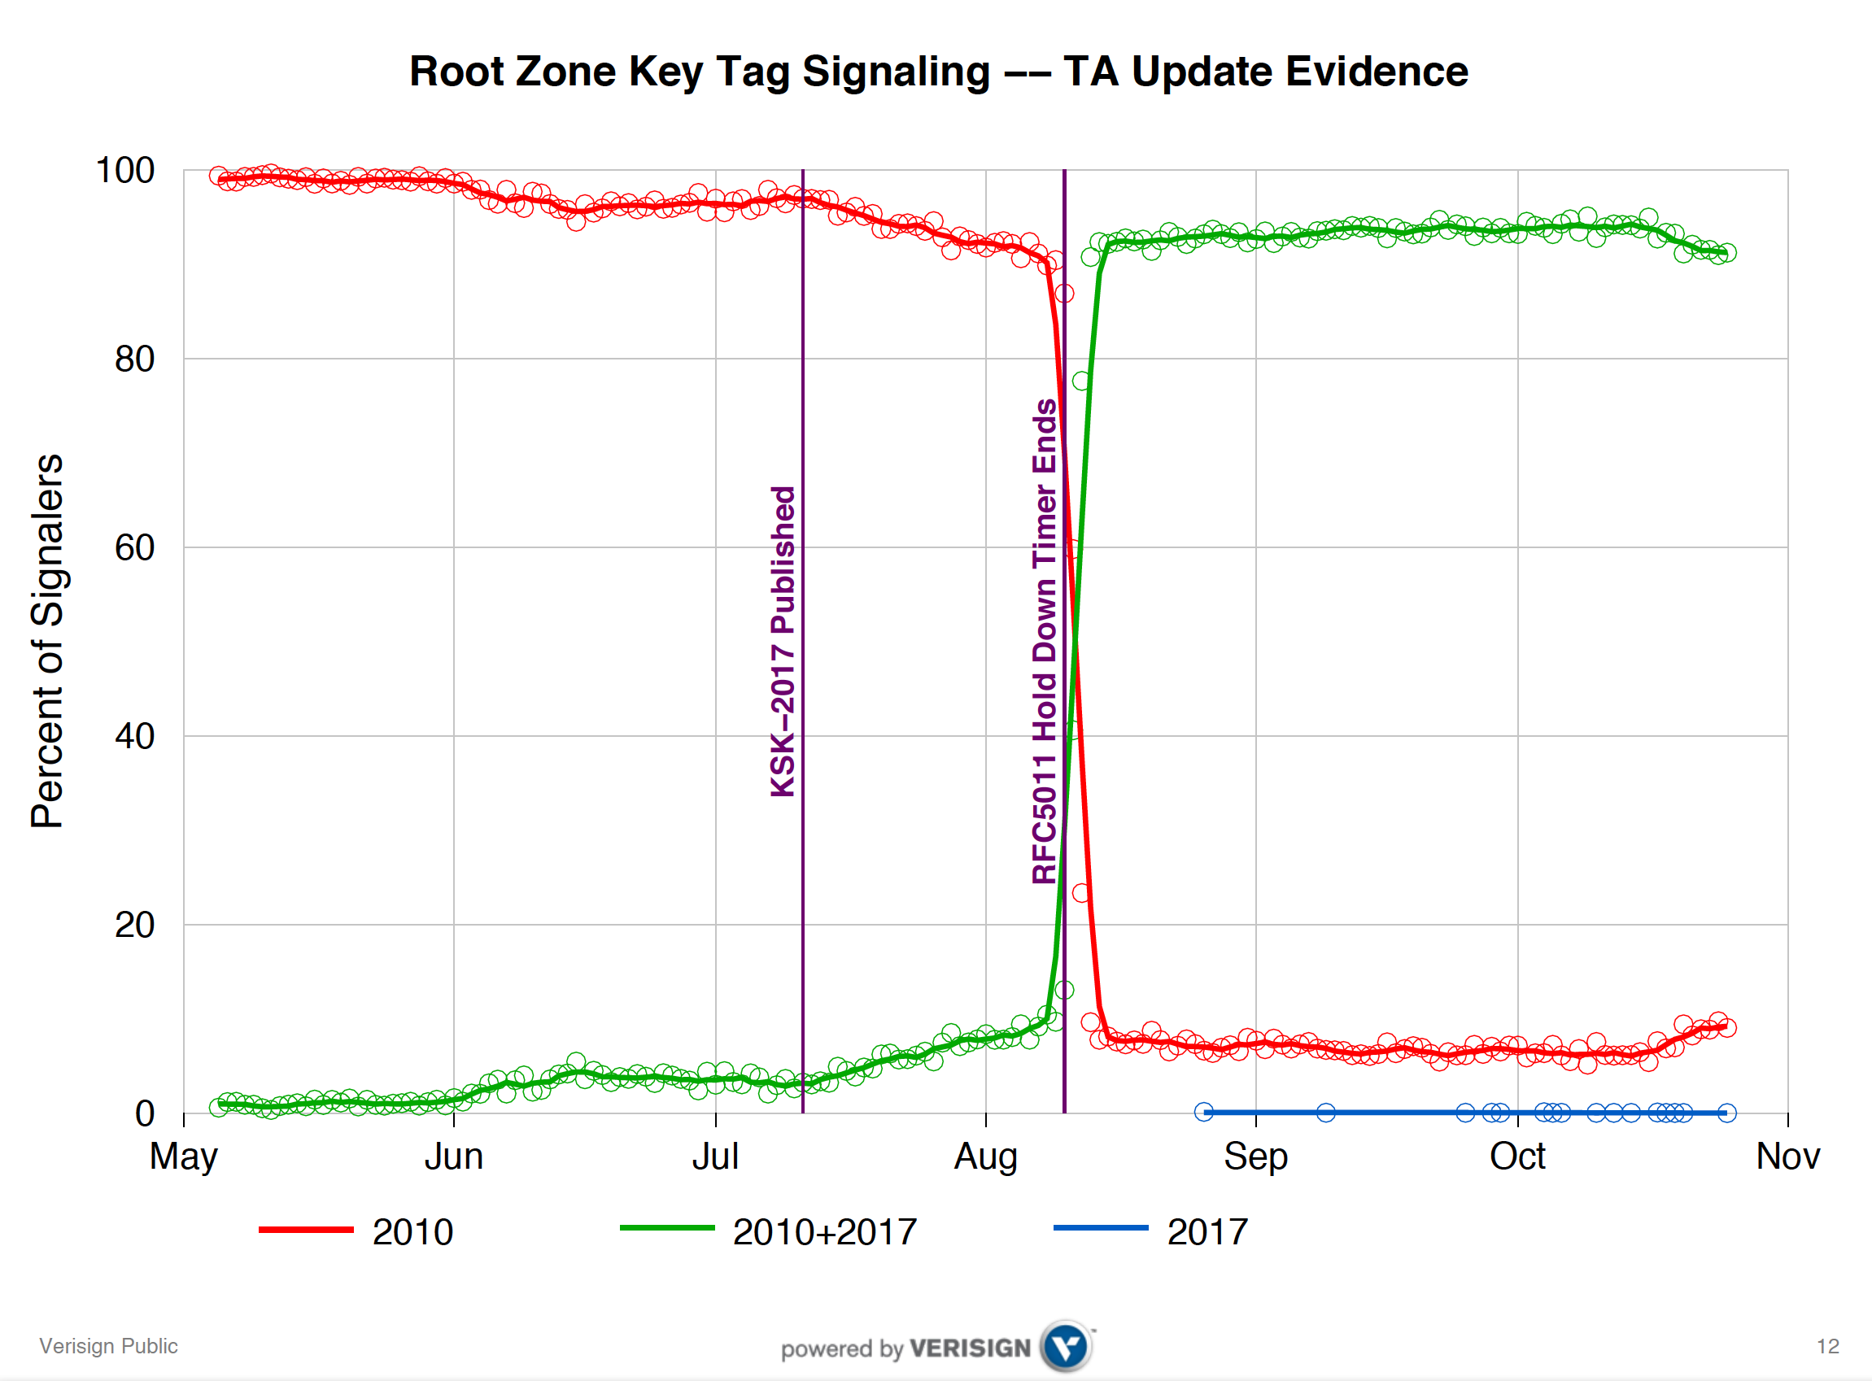
What did we see at the roots?
Duane Wessels VeriSign RFC 8145 Signaling Trust Anchor Knowledge In DNS Security Extensions
Presentation to DNSSEC Workshop @ ICANN 60 – 1 Nov 2017
https://schd.ws/hosted_files/icann60abudhabi2017/ea/Duane%20Wessels-VeriSign-RFC%208145-Signaling%20Trust%20Anchor%20Knowledge%20in%20DNS%20Security%20Extensions.pdf

Slide 9
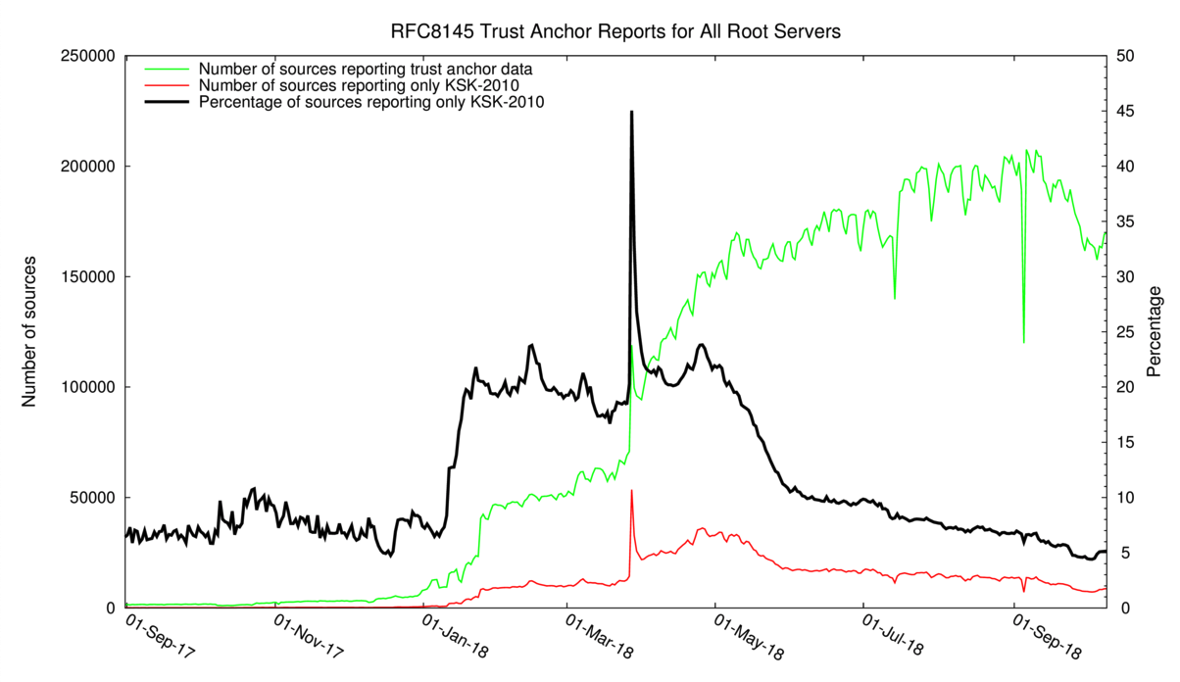
12 months of RFC8145 signalling
Yes, with just a few days to go this mechanism was still reporting 5% ‘breakage’
http://root-trust-anchor-reports.research.icann.org

Slide 10
What is this saying?
It’s clear that there is some residual set of resolvers that are signalling that they have not yet learned to trust the new KSK key
But its not clear if:
  This is an accurate signal about the state of this resolver
  This is an accurate signal about the identity of this resolver
  How many users sit ‘behind’ this resolver
  Whether these uses rely solely on this resolver, or if they also have alternate resolvers that they can use
  What proportion of all users are affected

Slide 11
Why?
Because the DNS does not disclose the antecedents of a query
  If A forwards a query to B, who queries a Root Server then if the query contains an implicit signal (as in this case) then it appears that B is querying, not A
  At no time is the user made visible in the referred query
Because caching
  If A and B both forward their queries via C, then it may be that one or both of these queries may be answered from C’s cache
  In this case the signal is being suppressed
Because its actually measuring a cause, not the outcome
  Its measuring resolvers’ uptake of the new KSK, but is not able to measure the user impact of this

Slide 12
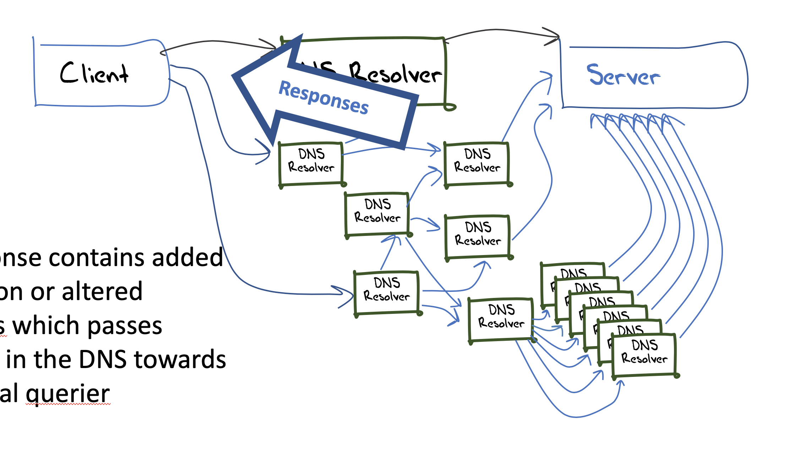
User-Side Measurement
Can we devise a DNS query that could reveal the state of the trusted keys of the resolvers back to the user?
  Not within the current parameters of DNSSEC and/or resolver behaviour

Slide 13
User-Side Measurement
Can we devise a DNS query that could reveal the state of the trusted keys of the resolvers back to the user?
  What about a change to the resolver’s reporting of validation outcome depending on the resolver’s local trusted key state?
    If a query contains the label “root-key-sentinel-is-ta-<key-tag>” then a validating resolver will report validation failure if the key is NOT in the local trusted key store
    If a query contains the label “root-key-sentinel-not-ta-<key-tag>” then a validating resolver will report validation failure if the key IS in the local trusted key store

Slide 14
DNS + Web
How can you tell if a user is able to resolve a DNS name?
  Be the user (get the user to run a script of some sort)
  Look at the DNS server AND the Web server
    The Web object is fetched only when the DNS provides a resolution answer
    But the opposite is not necessarily the case, so there is a noise component in such an approach

Slide 15
Prior to the KSK Roll
16% of users use DNSSEC-validating resolvers
15% of users do not report
their KSK trust-state
0.5% of users report KSK-2017
loaded
0.005% of users report KSK-2017
NOT loaded

Slide 16
Possibly Affected Users
Between 0.1% to 0.2% of users are reporting that their resolvers have not loaded KSK-2017 as a trust anchor
The measurement has many uncertainties and many sources of noise so this is an upper bound of the pool of users who may encounter DNS failure due to to the KSK roll

Slide 17
But
Not all resolvers will pre-provision KSK-2017 using RFC 5011 automated trust mechanisms – they may elect to load the new trsut anchor at the time of the roll manually
  And we cannot measure the difference between a resolver that has a broken implementation of RFC5011 and a resolver that is being managed manually
Only recently upgraded resolvers have this test behaviour included
  But the resolvers we worry about are the crufty ones at the bottom of the rack that have been all but forgotten!

Slide 18
What happened
Sidn Labs Atlas Measurement

Slide 19
What we saw
% of folk that reported “good”
KSK roll period
% of folk that reported “bad”

Slide 20
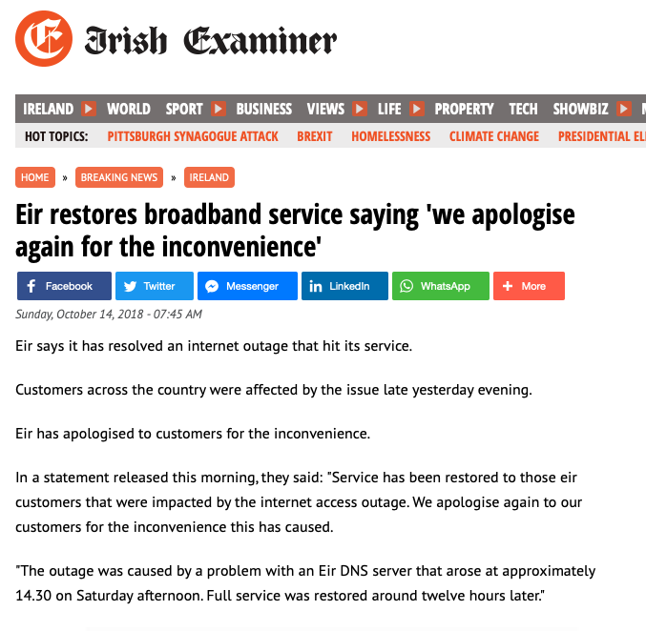

What we heard

Slide 21
What happens when you lose track of the KSK?

Slide 22
Everything goes black

Slide 23
AS5466 DNSSEC Data
Daily Sample Count
Validating Sample Count
KSK Roll Cache Expiry

Slide 24
Internet DNSSEC Data
Is this related to the KSK Roll?

Slide 25
Looking for Affected Networks
More than 1,000 samples / day in the lead up to the KSK roll
DNSSEC validation level more than 30% prior top the KSK roll
Drop of more than 33% in DNSSEC validation during the KSK roll

Slide 26
Rank AS CC Seen Validating AS Name
Before During After Before During After
1 AS9541 PK 10,201 4,953 6,273 4,651 2,644 2,773 CYBERNET-AP Cyber Internet Services (Pvt) Ltd., Pakistan
2 AS38264 PK 6,001 2,464 3,123 2,794 1,309 1,443 WATEEN-IMS-PK-AS-AP National WiMAX, Pakistan
3 AS45773 PK 4,736 732 2,568 1,850 336 996 HECPERN-AS-PK PERN AS Content Service, Pakistan
4 AS22616 US 3,212 1,225 3,539 2,244 918 2,351 ZSCALER-SJC1 - ZSCALER, USA
5 AS17557 PK 2,555 811 1,430 1,318 522 759 PKTELECOM-AS-PK Pakistan Telecommunication, Pakistan
6 AS9231 HK 2,056 1,300 3,277 1,973 1,277 3,193 IPEOPLESNET-AS-AP China Mobile Hong Kong, Hong Kong
7 AS5438 TN 1,745 1,924 2,082 1,646 717 100 ATI, Tunisia
8 AS135407 PK 1,742 429 845 1,282 391 636 TES-PL-AS-AP Trans World Enterprise Services, Pakistan
9 AS9658 PH 1,723 453 1,193 814 220 575 ETPI-IDS-AS-AP Eastern Telecoms, Philippines
10 AS5466 IE 1,670 743 1,471 1,280 569 1,208 EIRCOM Internet House, Ireland
11 AS24691 TG 1,458 808 1,608 466 257 554 TOGOTEL-AS TogoTelecom, Togo
12 AS23956 BD 1,438 568 1,016 956 480 855 AMBERIT-BD-AS AmberIT, Bangladesh
13 AS9381 HK 1,403 338 1,241 891 251 832 WTT-AS-AP WTT HK Limited, Hong Kong
14 AS10396 PR 1,383 1,110 1,320 1,272 248 20 COQUI-NET - DATACOM CARIBE, Puerto Rico
15 AS37228 RW 1,262 279 909 398 117 241 Olleh-Rwanda-Networks, Rwanda
16 AS17563 PK 1,225 222 663 632 121 368 NEXLINX-AS-AP Nexlinx, Pakistan
17 AS7590 PK 1,218 231 606 810 160 413 COMSATS Commission on Science and Technology, Pakistan
18 AS15964 CM 1,159 583 1,868 464 241 731 CAMNET-AS, Cameroon
19 AS37425 SO 1,148 957 1,114 521 343 517 Somcable, Somalia
20 AS45588 BD 1,013 444 776 517 188 350 BTCL-ISP-AS Bangladesh Telecommunications, Bangladesh

Slide 27
Potentially Impacted Networks
Rank AS CC Seen Validating AS Name
Before During After Before During After
1 AS9541 PK 10,201 4,953 6,273 4,651 2,644 2,773 CYBERNET-AP Cyber Internet Services (Pvt) Ltd., Pakistan
2 AS38264 PK 6,001 2,464 3,123 2,794 1,309 1,443 WATEEN-IMS-PK-AS-AP National WiMAX, Pakistan
3 AS45773 PK 4,736 732 2,568 1,850 336 996 HECPERN-AS-PK PERN AS Content Service, Pakistan
4 AS22616 US 3,212 1,225 3,539 2,244 918 2,351 ZSCALER-SJC1 - ZSCALER, USA
5 AS17557 PK 2,555 811 1,430 1,318 522 759 PKTELECOM-AS-PK Pakistan Telecommunication, Pakistan
6 AS9231 HK 2,056 1,300 3,277 1,973 1,277 3,193 IPEOPLESNET-AS-AP China Mobile Hong Kong, Hong Kong
7 AS5438 TN 1,745 1,924 2,082 1,646 717 100 ATI, Tunisia
8 AS135407 PK 1,742 429 845 1,282 391 636 TES-PL-AS-AP Trans World Enterprise Services, Pakistan
9 AS9658 PH 1,723 453 1,193 814 220 575 ETPI-IDS-AS-AP Eastern Telecoms, Philippines
10 AS5466 IE 1,670 743 1,471 1,280 569 1,208 EIRCOM Internet House, Ireland
11 AS24691 TG 1,458 808 1,608 466 257 554 TOGOTEL-AS TogoTelecom, Togo
12 AS23956 BD 1,438 568 1,016 956 480 855 AMBERIT-BD-AS AmberIT, Bangladesh
13 AS9381 HK 1,403 338 1,241 891 251 832 WTT-AS-AP WTT HK Limited, Hong Kong
14 AS10396 PR 1,383 1,110 1,320 1,272 248 20 COQUI-NET - DATACOM CARIBE, Puerto Rico
15 AS37228 RW 1,262 279 909 398 117 241 Olleh-Rwanda-Networks, Rwanda
16 AS17563 PK 1,225 222 663 632 121 368 NEXLINX-AS-AP Nexlinx, Pakistan
17 AS7590 PK 1,218 231 606 810 160 413 COMSATS Commission on Science and Technology, Pakistan
18 AS15964 CM 1,159 583 1,868 464 241 731 CAMNET-AS, Cameroon
19 AS37425 SO 1,148 957 1,114 521 343 517 Somcable, Somalia
20 AS45588 BD 1,013 444 776 517 188 350 BTCL-ISP-AS Bangladesh Telecommunications, Bangladesh

Slide 28
Impact of the KSK Roll
The immediate impact appears to be some 0.4% - 0.5% of users
In 18 cases service was restored with DNSSEC validation enables
In 2 cases DNSSEC validation was turned off
7 of the 20 networks are in Pakistan
2 in Bangladesh
2 in Hong Kong
1 each in USA, Tunisia, Philippines, Ireland, Togo, Puerto Rico, Rwanda, Cameroon and Somalia

Slide 29
Lessons Learned
Yes, we can roll the KSK!
Yes, the extensive contact campaign helped
Yes, we can now look at an Elliptical Curve algo roll
Yes, we should we look at backup KSK provision?
Yes, we should review RTFC8145 and Key Sentinel and improve them or kill them off
Yes, we should look at a KSK bootup chain to automate synching old KSK configs into current production state

Slide 30
Keep It Rolling
Maybe we just need to keep rolling every year
  That way we train the manual loaders to keep up!

Slide 31
Thanks!

